Slide 1
AI&A BISQUAD Microsoft Azure Cloud Validation Approach

Slide 2


Cognizant/ Microsoft | 360° Partnership Overview
Groundbreaking 5-year initiative
Built on a deep 15-year relationship
Global Go-To- Partner for Cognitive Services
CEO driven focus on digital transformation
Winning Together
Sell, Build, and Enable Together
Leveraging Synergies
Industry Capability
Technology/Architecture
Knowledge and IP
Innovative Breakthroughs
Build Preferences
Impart Reliability
Deeper Customer Relevance
Higher Azure Consumption
“ The only sustainable advantage you can have over others is agility ”
“Our industry does not respect tradition, only innovation ”
Francisco D’Souza
Cognizant CEO
Satya Nadella
Microsoft CEO

Slide 3

Microsoft Partner of the Year Award Winner.
Microsoft Partner of the Year Award Winner.
Cognizant BigDecisions® Winner for the Data Platform Partner of the Year.
Cognizant BigDecisions® is an end-to-end System of Intelligence Platform that applies sophisticated, advanced analytics to complex data- of any scale - to extract actionable, valuable insights that lead to better decisions.
This achievement highlights our exceptional work in delivering Microsoft products and services that positively impact our mutual customers.

Slide 4






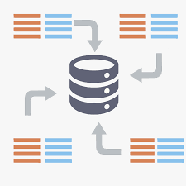
Cognizant’s AI & Analytics –BISQUAD Capabilities
2750+
Dedicated & focused independent verification & validation arm for Data QA with extensive AIM technology coverage
ETL: Informatica, Datastage, Abinitio, SSIS,ODI, OWB etc.
BI : Business Objects, Cognos, SSRS/SSAS, MSTR etc.
Database : Oracle, Teradata, Netezza, SQL Server, DB2 etc.
Big Data – Hadoop technologies
Well defined QA process controls, hand-off mechanisms, metrics monitoring and reporting procedures
Industry best practices, processes, standards, methodologies & tool sets
Resources
210+
Clients
Modernization and NextGen
AI, Analytics and Data Insights
DevOps-Data QA
BigData QA
Analytics/AI-Data QA
MDM/EDM QA
ETL/Structured Data QA
Jupiter
BRAVO
RAPID
MARS
Platinum
A Platform for Continuous Data Testing
Accelerates Dev. Ops-CI/CD, Cloud and Agile QA delivery.
QA Automation 50-60%
BigData Framework for validation and Optimization. Big Data QA effort reduction by 30%-40%
AI & Analytics driven QA Automation Solution, Intelligent Bot Network (ION)
MDM Automation & Regression Solution
MDM QA effort savings by 25-30%
Suite that helps accelerate ETL, DW/BI QA lifecycle phases
DW/BI QA effort reduction by 25% -30%
Benefits
Automation from the get go
Reusable libraries and integration with other CI tools
One repository for acceptance Criteria, test Scripts and results
Parser, Hadoop (Spark/MR) comparator, Hadoop script builder and executor
Analytical Model health checker and outlier analyser
Defect Clustering – Text mining of defect data to derive clusters for RCA
Regression Scenario Selection
Intelligent Bot for Test design and Execution
Open source (JMeter/Selenium) based toolkit
Support E2E MDM QA – data acquisition, core MDM (match/merge, survivorship), consumption services and UI
TASQ – Automated Test case designer and executor
Data Comparator
BI Report burstor/comparator
Data Analyzer and Generator
Provides the right insight for optimizing every stage of Software Life Cycle

Slide 5



What & Why Cloud Computing?
Cloud Computing
The practice of using a network of remote servers hosted on the Internet to store, manage, and process data, rather than a local server or a personal computer.
Speed
Scalablility
Cost Effectiveness
Faster than Traditional Application Development
Scale out quickly
Provide global Scale
Lower Cost
Lower Maintenance

Slide 6
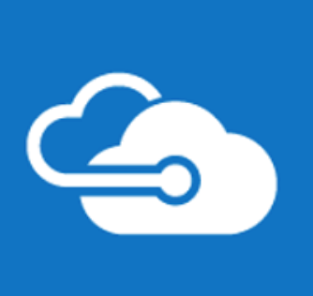



What is Microsoft Azure?
Build, Deploy and Manage Application across Global Network
Build Applications using any Language, Tool or Framework
Integrate Public Cloud application with your Existing IT Environment
Flexible cloud platform
IaaS (Infrastructure as a Service)
Infrastructure on Cloud, VMs, Network
PaaS (Platform as a Service)
OS, Storage, Middleware etc
SaaS (Software as a Service)
Microsoft, Oracle, SAP, Java, Sfdc etc

Slide 7










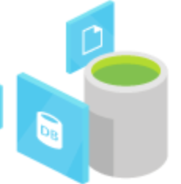
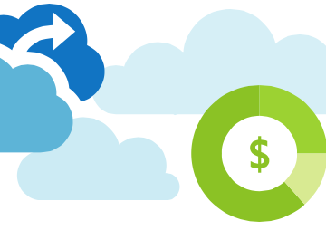
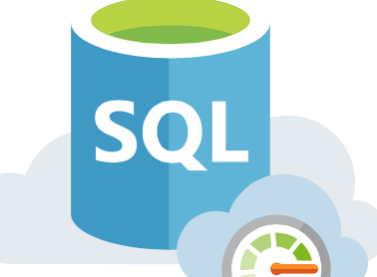

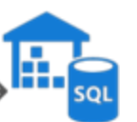

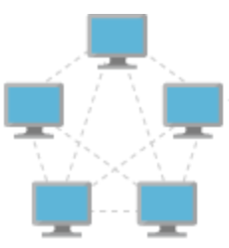

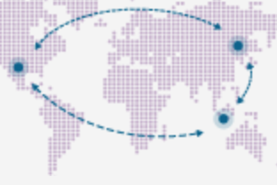
Azure Services
Web+ Mobile Service
Quickly create powerful cloud apps using a fully-managed platform
Web Apps
Mobile Apps
API Apps
Logic Apps
Compute
Azure Virtual Machines gives you the flexibility of virtualization for a wide range of computing solutions—development and testing, running applications and extending your datacenter.
Virtual Machine
Functions
App Service
Cloud Service
Storage
Offload the heavy lifting of datacenter management. Fast, familiar and flexible analytics platform for enterprise
Blob Storage
Disk Storage
Data Lake Storage
Back-up
Data Service
The intelligent relational cloud database service.
Fast, familiar and flexible analytics platform for enterprise. Hybrid data integration at scale, made easy by Data Factory
SQL DB
Machine Learning
SQL DW
Data Factory
Network
Your private network in the cloud. Deliver high availability and network performance to your applications. Route incoming traffic for high performance and availability.
Virtual Network
Load Balancer
Traffic Manager
IaaS (Infrastructure as a Service)
PaaS (Platform as a Service)
SaaS (Software as a Service)

Slide 8

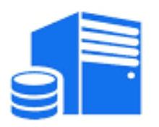





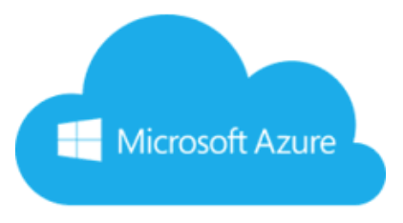
















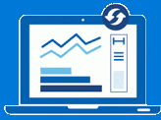










Azure Cloud Data Validation Framework
Data Cleaning
Transform
Aggregate
Load
On Premise
Azure Cloud
IaaS
PaaS
SaaS
Source
Ingestion
Compute [Processing /Transformation]
Storage [Data Warehouse]
Visualization
1
2
SSRS
Batch to Staging
VM Role
Web Role
Worker Role
Disk
Data Processing & Movement
SharePoint
ETL
Blob
Storage
Excel BI
Files
Visualizations
Tables
Power BI
SQL DB
Real – time Data
Stream Analytics
HD Insight
Data lake Store
Datazen
Azure ML
SQL Server Analysis Services
Files
Event Hub
3
Azure Data Factory
Queue
Tableau
Rule based Data validation & Non Transformed data comparison
Data Comparison, Security & Performance validation
BRAVO : Big data Framework for Validation & Optimization
1
2
3
QA Tools &
Accelerators
Source Data Analyzer
Data Ingestion QA
Data Lake Processing QA
Analytics QA
Text Mining QA
6
Notes:
DW Architecture
This Data Warehouse uses Azure technologies. Data arrives to the landing zone or staging area from different sources through Azure Data Factory. We use Azure Data Factory (ADF) jobs to massage and transform data into the warehouse. Once ready, the data is available to customers in the form of dimension and fact tables.

Slide 9
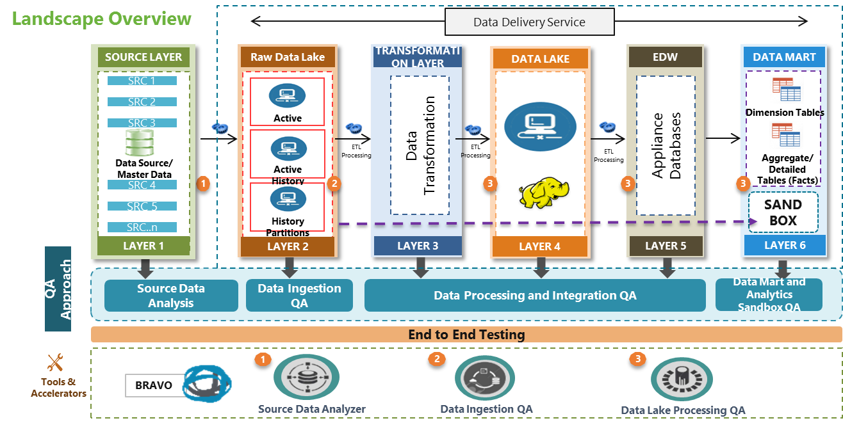
BRAVO – Big data Framework for Validation & Optimization
7

Slide 10




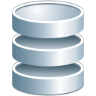



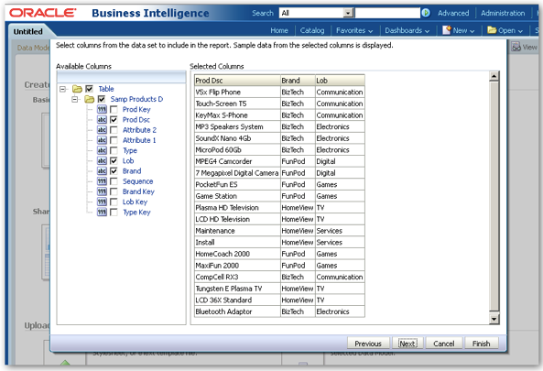
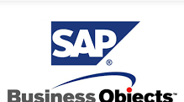




Detail Test Coverage Approach
Test Strategy:
For the data migrated from the source database/system to the Target database/system, Test Coverage involves ensuring the data correctness and the data completeness of the migrated data in the Target database/system against the source database/system. This involves the primary validations that follow -
Data Ingestion Checks to confirm the migration of data from source to target is successful and correct
Metadata validations between source and target database/system
Data comparison between source and target database/system
Source Database
Target
Database
Landing
On Premise/Cloud
On Cloud
Staging
Full / Incremental tables
Full / Incremental tables
Mainframe
Compare
LAYER 1
LAYER 1
Other database
Core
Foundation
Compare
Files
History/Full / Incremental tables
History/Full / Incremental tables
Web Application
LAYER 2
LAYER 2
SQL DB
Compare
File systems
QA Strategy
Metadata Validation
History/Full/Incremental data Validation
Report Validation
ETL and BI Performance Testing
Automation Components
Metadata Reconciler
DataLake Processing QA
Report Comparator
8

Slide 11
Migration Test Coverage
S.No | Validation Type | Description | For More details
1 | Batch Run Validation | Validation of end to end workflow to ensure migration of data from source to target is successful with all dependencies mapped.
2 | Metadata Validation | The table structure defined in the target database/system is as per the source tables/system and is as per the requirement mapping document | Click here
3 | Automated Test Design | Creation of test cases and test scripts as per the test requirement based on volume and partition key for each of the tables considered under migration in an automated manner | Click here
4 | Data Validation | Comparison of the complete history data for its count and data between the source tables/system and the target tables/system Comparison of the delta data for its count and data loaded in both the source tables/system and the target tables/system including the Incremental logic validation like Inserts, Updates, Deletes, etc. | Click here
5 | Report Validation | Comparison of the reports generated out of the source database/system against the Target database/system for the same set of data volume | Click here
6 | Performance Testing Approach | Validation of the performance of ETL jobs / Reports rendering against the Baseline provided by the Business | Click here
9
Notes:
DW Architecture
This Data Warehouse uses Azure technologies. Data arrives to the landing zone or staging area from different sources through Azure Data Factory. We use Azure Data Factory (ADF) jobs to massage and transform data into the warehouse. Once ready, the data is available to customers in the form of dimension and fact tables.

Slide 12
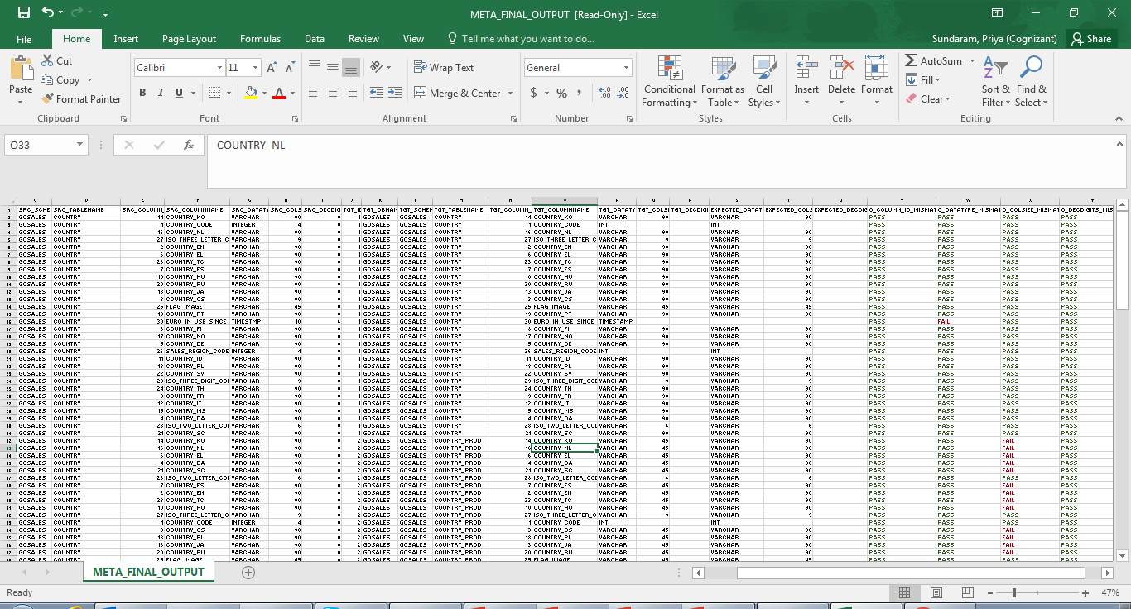
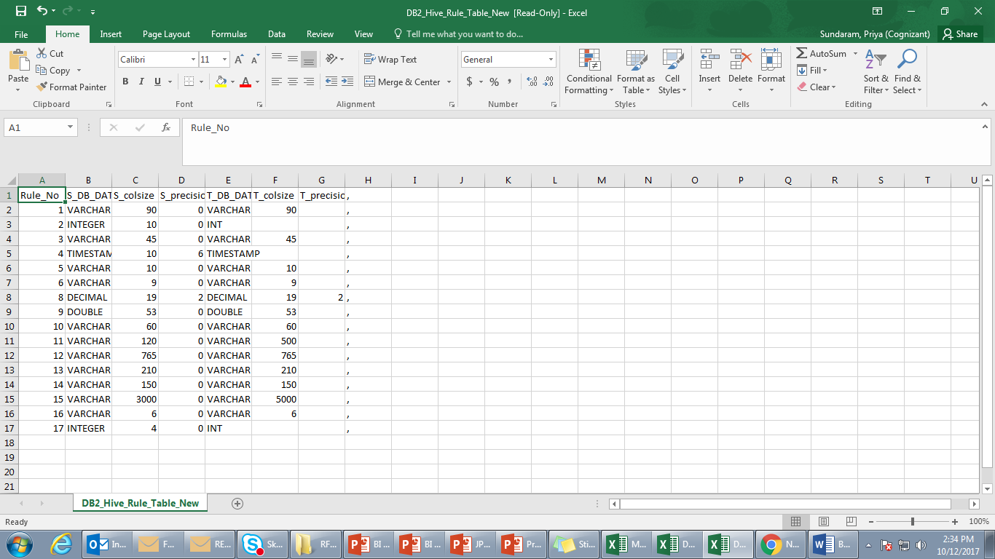
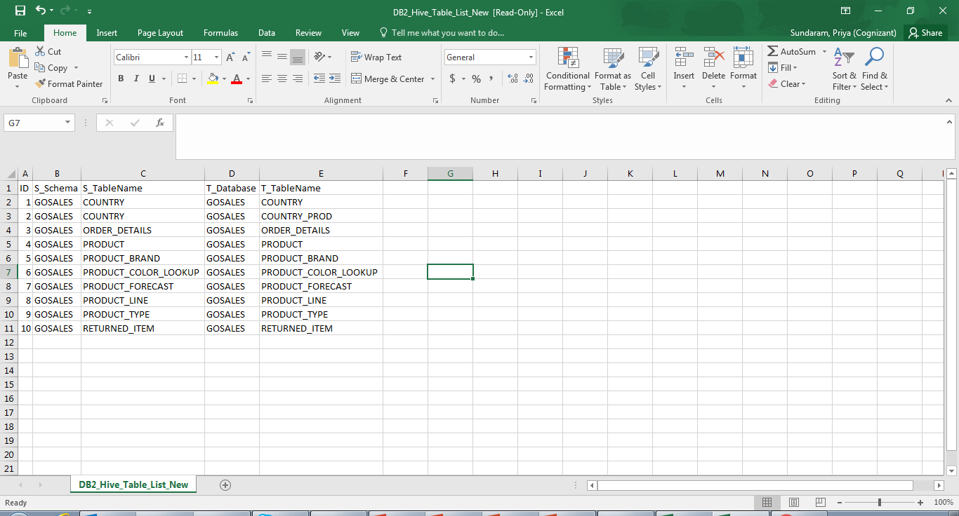
Testing Approach – Metadata Validation
Tables / Views that are considered as part of migration are compared in an automated manner for their structure between the source database/system and the Target database/system. The comparison results are obtained which can be further analyzed on the mismatches with ease.
Source Database
BRAVO (Metadata Reconciler)
On Premise/Cloud
Tables/
Views
Source Metadata Details
01
Database/ Connection Details
SOURCE
02
04
Comparison Output
Schema Information
Metadata Reconciler
Metadata Rule
Definitions
Target Database
On Cloud
Target Metadata Details
03
Metadata Validation Output
Tables/
Views
Table / View
Names
Excel Import Feature
TARGET
Back to Coverage Types

Slide 13
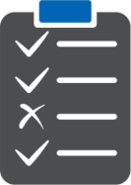
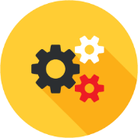


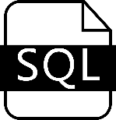

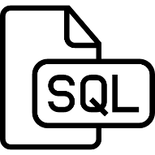
Testing Approach – Automated Test Design
SQL queries are automatically created for each of the Source and Target Tables / Views considered as part of migration based on the Segmentation Column. The segmentation size determines the number of segments in the table. For eg. a table with size 1000000 records and segmentation size is 100000 then there will be 10 SQL queries created for that table in both Source and Target with ease and with no manual intervention
1. Access the Source and Target environment to understand the Cluster capacity (no of Cores,RAM size etc)
BRAVO - Data Lake Processing QA
Due Diligence
2. Derive the segmentation size of each partition based on the Table / View volume statistics
Segmentation
Segmentation Size
Derive segmentation Logic
Test Engineer
Segmentation Column
Query Generation
Identify the segmentation column by data profiling
Data Segmentation Queries
Data Profiling
Click here to Go back
Back to Coverage Types

Slide 14





Testing Approach – History/Incremental Data Validation
Data Validation involves comparing of the source database/system against the target database/system for both the History data and the Incremental data. For both validations, same data set is used for loading the source and the Target database/system
On Premise/Cloud
On Cloud
History Validation
For History migration, no transformations are considered and is as-is migration
Count checks are performed between source and target database/system
Data Validation is performed between the source database/system against the target database/system based on table volume
Cell to cell validations are performed for low volume tables
Segmentation is performed for high volume tables and each segment is subjected to cell to cell comparison
Reports created out of history data in both source and target database are compared and test results are created
Incremental Validation
For Incremental validation, transformation logics are considered
Count checks for the delta load are performed between source and target database/system
When Delta load volume is low, cell to cell comparison is performed. Segmentation is followed and cell to cell comparison is performed for each segment
Incremental load refresh validation – Daily/ Weekly/ Yearly is performed using the same data set between source and target database/system
Incremental load types is tested for SCD using the same data set between source and target database/system
Reports created from incremental data is compared and test results are created
Source Database
Target Database
QA Hadoop
Cluster
BRAVO Engine
DWH Layer
DWH Layer
Segment. 1
Compare
Segment. 1
Tables/
Views
Tables/
Views
Segment 2
Compare
Segment 2
SOURCE
Segment. n
Compare
Segment. n
TARGET
Compare
Table/View Validation
Report Validation
Report Validation
Data Lake Processing QA
Data Comparator
Report Comparator
Back to Coverage Types

Slide 15




Testing Approach – Report Validations
On Prem : BI Reports
Testing Approach
SIT Approach will be to compare the reports generated from reports pointing to source database against the reports pointing to the Target database
Run Reports and Export to Excel
Setup required
data in EDW
2
1
Run BI Reports
Export Data to Excel
Source Database
Perform Report Comparison
Comparison of Data with output from Source Database Reports with Target database reports
3
BI
Report Output
4
Data Validation – Report Validation
Report Comparator will be used for data comparison by extracting the reports in Excel format.
Excel files will be compared as part of Data Comparison for the given input value to verify:
Data between Source database generated reports and Target database generated reports
On Cloud : BI Reports
Report
Comparator
5
1
Setup required
data in EDW
Run BI Reports
2
Export Data to Excel
Observe result set and flag issues for any Data mismatch
Target Database
3
15
BI Report Output
Back to Coverage Types

Slide 16
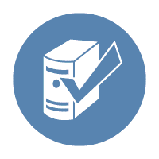







Performance Testing Approach
History Migration
Incremental Migration
Reports Performance Post Migration
SIT Completion
Capture the migration cut over schedule window
Monitor the history load execution runtime and schedule in Target environment
Identify the select set of jobs for performance testing on Incremental Loads
Establish baseline for Source system based on the run/requirement document
Capture runtime statistics for Target system
Identify the select set of reports for performance testing
Baseline the run time statistic for BI reports pointing from Source
Run and measure the report runtime statistics in Target environment
Compare the run times of the reports and report anomalies in case of deviations greater than threshold
Report performance issue in case the migration cut over exceeds the scheduled down time.
Compare the run times of data load jobs in Source and Target environments and report deviations greater than threshold
Flag in case of any variations from threshold
Key Considerations
16
Automated Reconciliation Scripts to reconcile data between Teradata & SAP HANA/Hadoop
Cognizant Test Team provides detailed Test Plan and coordinates Regression/UAT Testing with SCE users
Environment comparable to production Volume
Baselined Runtimes and Threshold
Seamless and adequate data provisioning
Environment Stability and availability during critical times
Back to Coverage Types

Slide 17



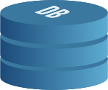




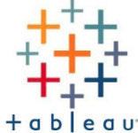

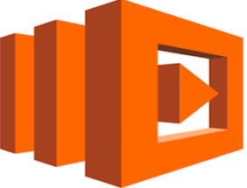



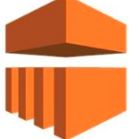


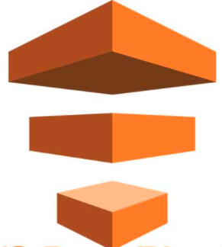
Case Study : Amazon Web Services (AWS) QA in leading Health Insurance
Amazon Analytics
Business Driver:
QA: To provide QA services (data quality-correctness , Integrity & Domain E2E) for the new member data hub implementation on AWS Cloud from various on premise data sources.
Implementation: 40+ Data files from various sources to load Member Demography, Member benefits, State Medicaid member demography, Group/Employer, Medicaid Retention.
Challenges: On demand data accessibility challenges from SAS data model by various business users , Cost, Maintenance
Solution Highlights :
Data Hub on AWS Cloud and integrate with Tableau & Alteryx Analytics(adhoc reporting from cloud) and 100+ downstream users to consume Tableau dashboards build on top of AWS Redshift database
QA: Implemented automation framework using Spark and cognizant In-house PLATINUM automation accelerator with Jenkins for layer based data validation, End to End testing & business validation on AWS, Ensured the AWS services configured for each layer is verified
On Premise
AWS Cloud
On Premise
SOURCE
QG11
Business & End Users
QG2
Landing Zone
(Member Enrollment & Benefits)
Raw Zone
(Member Enrollment & Benefits)
Refined Zone
(Member Enrollment & Benefits)
AWS S3
Adhoc Analytics Reporting
Published Zone
(Member Enrollment & Benefits)
Access Reports via
AWS console
MDM
QG12
Data Ingestion
Transformation
Publish
Publish
QG4
QG6
QG8
AWS Cloud
Lambda
Data Pipeline
AWS Redshift Copy Cmd – SQL Services
QG1
EMR
Member Demography,
Benefits, State Exchange Medicaid member,
QG7
QG9
QG10
QG3
QG5
Publish - 2 RedShift Task
AWS Copy Cmd Services
Ingest Task
Transform Task
Publish Task
RedShift
Ingestion- Landing to Raw
Raw to Refined
Refined to Published
Published to Redshift & End User Reporting
Data Pipeline config. Verification
40+ Member data CSVs validated
Beyond Compare Tool - Validation between On Premise Landing and AWS Landing zone.
Lambda Notifications
Data Validation performed using Apache Zeppelin utility in cloud
Spark commands to read CSV, Avro files
Spark mode - Volatile table in landing zone
Amazon Redshift SQL mode for data validation
Measure performance of Spark jobs
Data Validation performed using Apache Zeppelin utility in cloud
Spark commands to read Avro files
Spark mode - Volatile table in landing zone
Amazon Redshift SQL mode for data validation
Measure performance of Spark jobs
Data Validation for Redshift model
Report & dashboard validation for Tableau
Report creation & validation in Alteryx Analytical reporting.
AWS Redshift copy command to extract data from published
Data Validation performed using Cognizant In-house PLATINUM
Jenkins- Platinum Integration for Continuous data testing
PRE-LANDING
AWS services used : Amazon Web Console, S3–Simple Storage Services, Data Pipeline - AWS Work flow monitor via EMR, EMR (elastic map reduce) service-managed cluster platform to run the distributed frameworks like Hadoop/spark. Lambda – On demand cloud computing by AWS. Pay per usage

